Slide 1
Project 2
Title: Blackjack
Course: CIS-5
Section: 41595
Date: February 12, 2023
Author: Vincent Phan

Slide 2
Table of Contents
Introduction
Pseudo Code
Flowchart
Game Play and Rules
Development Summary

Slide 3
1. Introduction
Blackjack is the most widely-played casino banking game in the world. These types of games for gambling are generally considered a less-skilled card game where one or more players play against a banker who controls the game. The game of blackjack uses 52-card decks, typically with 2-7 players. Furthermore, players do not compete against one another; blackjack is a comparing card game in which each player individually competes against the dealer.
The objective is to win money by creating card totals higher than the dealer’s while not exceeding 21. A player may also win by stopping at a total close to 21 in hope that the dealer will “bust,” or exceed 21 when trying to beat the player. On their turn, players can “hit” (take an additional card), “stand” (end their turn without taking a card), “double” (double their wager and taking a single card, ending their turn), “split” (if the two initial cards have the same value, split them to create two separate hands), or “surrender” (give up half their bet and end their participation in the round).
Number cards are counted as their number. Jacks, queens, and kings (“face cards”) are each counted as 10. Aces are counted as either 1 or 11, depending on the player’s choice. Players bust and immediately lose their bet when their total exceeds 21. After all players are finished, the dealer’s hand is drawn until their total is at least 17. The dealer cannot double, split, nor surrender. If the dealer busts, all remaining players win. If not, the remaining players with totals higher than the dealer win while those with hands lower than the dealer lose.

Slide 4
2. Pseudo Code
START
Declare variables for deck, player’s hand, name, dealer’s hand, player’s $500 starting balance, and bet amount.
Prompt for player’s bet amount.
Deal two cards to player and dealer.
Check if any dealt cards are aces, then prompt for 1 or 11.
Prompt player if they want to hit, stand, or double.
Determine player’s hand value by adding their cards.
If player’s hand = 21 on first two cards, player wins unless dealer has blackjack also.
If choosing double, player’s bet is doubled and is dealt exactly one more card.
If player busts, dealer wins outright. If player’s hands < 21, repeat prompt for hitting or staying, but not doubling.
If hit, add another card and check hand value.
If stay, dealer reveals cards and hits until greater than 17, then continues hitting until greater than or equal to player’s hand.
If 21 on first two cards for dealer, dealer wins unless player has blackjack, which is a tie.
Determine winner based on hand values and blackjack, announce result. Add or subtract bet amount from player’s balance.
Display number of wins, ties, losses, win rate percentage, and current balance.

Slide 5
2.1 Pseudo Code Cont.
Prompt if player would like to play again if balance > 0, repeat entire process if yes.
If no, prompt if player would like to view last session’s stats and display if yes.
If not, save current session’s stats to winloss.txt for review next session.
EXIT

Slide 6
4. Flowchart
Please see attached flowchart file.

Slide 7
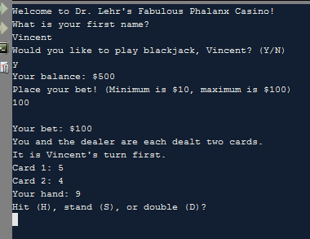
4. Gameplay and Rules
Players are greeted when starting the program and are prompted for their name. After, they are asked if they would like to play. Entering “Y” or “y” starts the game while entering “N” or “n” or any other character exits the program.
The player is shown their starting balance before being asked for their bet amount. They are then dealt two cards. If any ace is drawn, the player must choose 1 or 11 for its value. Both cards are shown to the player before prompting on aces. Their current hand is also displayed. If the player does not have blackjack, they are asked if they want to hit, stand, or double.

Slide 8
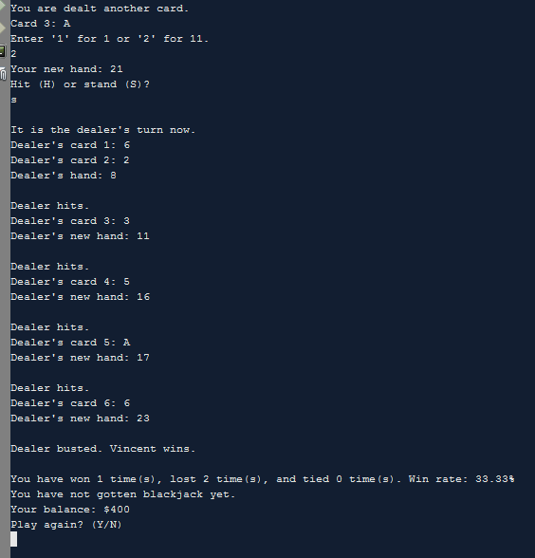
Hit: Take an additional card. This may be done as many times as they desire.
Stand: Take no more cards, ending their turn.
Double: Double their bet and take exactly one card, ending their turn.
If your hand total goes over 21, you bust and immediately lose.
Shown is an example of hitting, standing at 21, and winning. My bet of $100 is added to my balance of $300.
Your wins, losses, ties, win rate, blackjacks, and current balance are displayed after each round. The player is also prompted if they would like to play again if their balance is above $0.

Slide 9
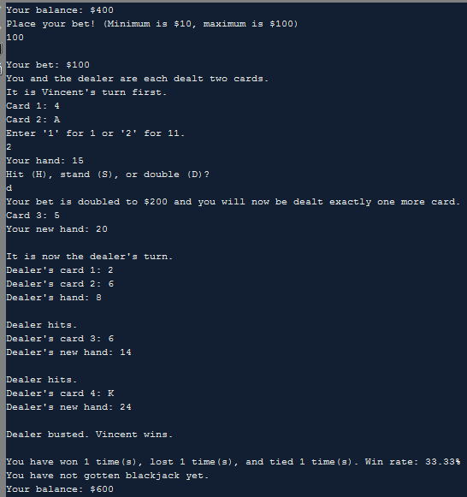
An example of doubling and winning $200.

Slide 10
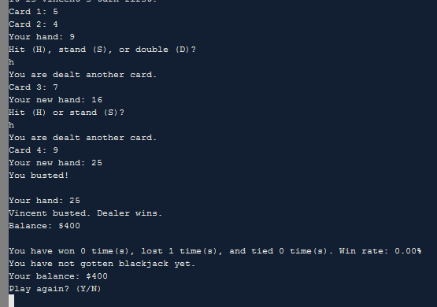
An example of hitting twice and busting, losing immediately. My $100 wager is subtracted from my original balance of $500.

Slide 11
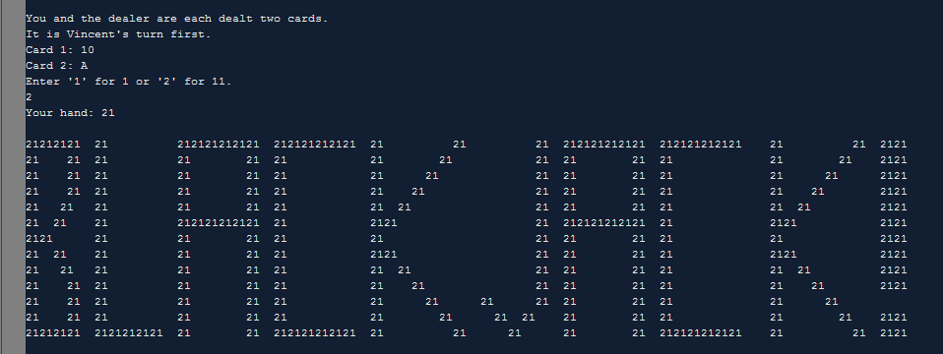
The player immediately wins if their total on the first two cards is 21 (“blackjack”), unless the dealer also has blackjack. A blackjack beats all hands that are not blackjack, even if their total is 21. Additionally, this large BLACKJACK banner made of “21” is displayed if the player has blackjack.

Slide 12
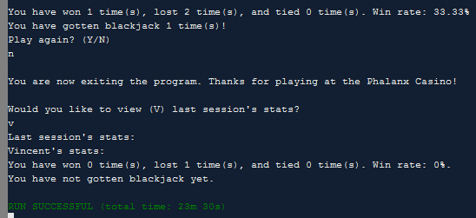
Declining to play again allows the player to view their last session’s cumulative stats. Before the program closes completely, the current session’s stats overwrites the previous stats in a .txt file named winloss.txt for future review. Not shown is the player’s current balance.

Slide 13
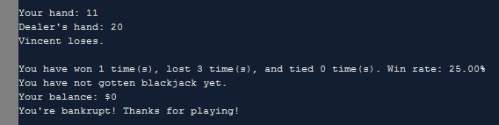
Once the player’s balance reaches $0, the program ends. However, the player may restart the program in order to play again, starting at a fresh balance of $500.

Slide 14
5. Development Summary
Total lines of source file: 793
I used NetBeans IDE. Design and coding took approximately 31 hours. I found the project quite fun and very satisfying to work on, but also extremely time consuming and difficult to develop because I had originally written over 600 messy lines for project 1. I am overall proud of my work, but my game is not where I would like it to be due to time constraints.

Slide 15
5.1 Version 0 Comments on Development
Total lines: 766
Here I expanded upon the original project by adding a betting system and finishing the double option. I also fixed the issue of prompting for ace before the second card is shown. I also implemented some functions like card dealing, checking for bust, and adding/subtracting the player’s bet from their balance when winning/losing. Version 0 is my last working and completely functional version.

Slide 16
5.2 Version 1 Comments on Development
Total lines: 793
I attempted to implement arrays for the deck of cards but was unfortunately unable to finish this version. The array works and displays, but I could not figure out how to properly assign hand values to the dealt cards.

